Slide 1
ROCO504 GROUP PROJECT
Advanced Robot Design

Slide 2
Introduction to Project and Project Goals

Slide 3
Introduction to Project and Project Goals
Title:
“A Soft Touch”

Slide 4
Introduction to Project and Project Goals
Prosthetic Human Hand

Slide 5
Introduction to Project and Project Goals
Prosthetic Human Hand
. Self Contained
. Variable Compliance
. Agonist-Antagonist Actuation

Slide 6
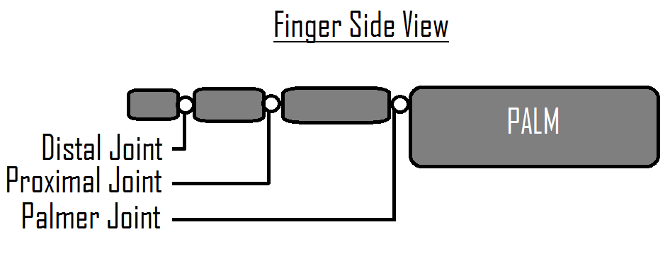
Design Principle:
Each Finger:
Actuated by 3 Motors :
-Palmar Joint
-Proximal and Distal Joint Linked
-Tension Tendon

Slide 7
Design Principle:
Tendons:
Made from a flexible material which is then winched
Materials:
Ninjaflex, Semiflex, PP, Nylon, Elastic

Slide 8
Design Principle:
Feedback:
A Potentiometer Embedded in each Joint
Motor Current Reading

Slide 9
Design:
CAD

Slide 10
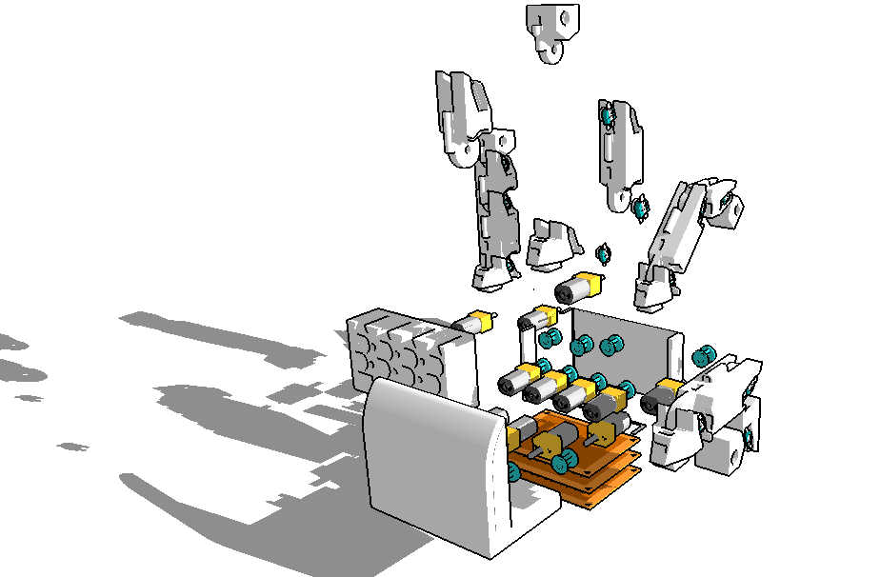
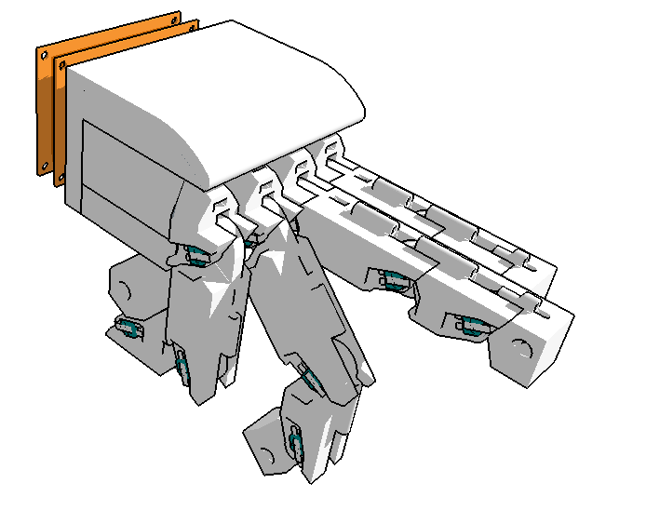
Design:

Slide 11
Design:
Electronics

Slide 12
Design:
Quantity | Component
16 | 12V 300RPM DC Motor with Gearbox
16 | L9110 Motor Drivers
16 | Shunt Resistors for current feedback
16 | Trim Potentiometers
5 | At-tiny 84
2 | 4051N 8-bit Analogue Shift Registers
1 | Arduino Nano
1 | LM358N Dual Op-Amp

Slide 13
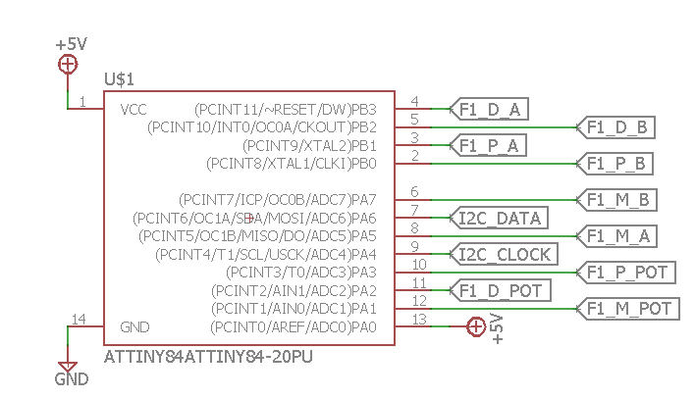
Design:
AT-Tiny 84 Pin-Out

Slide 14
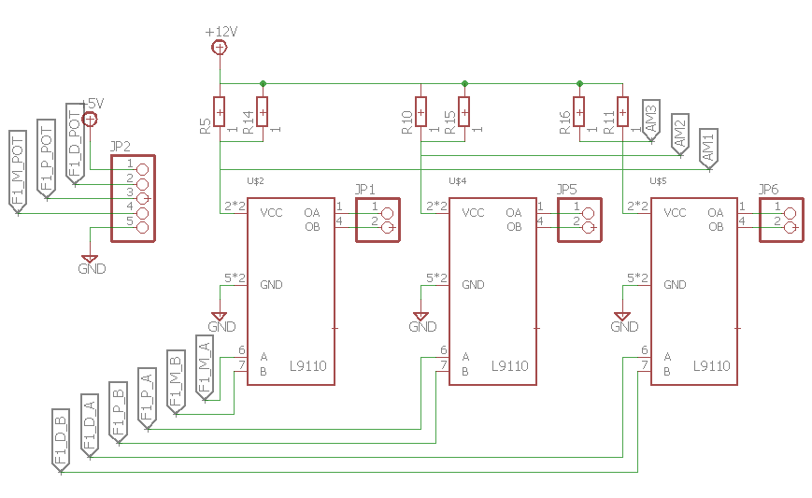
Design:
Motor Driver Wiring Diagram

Slide 15
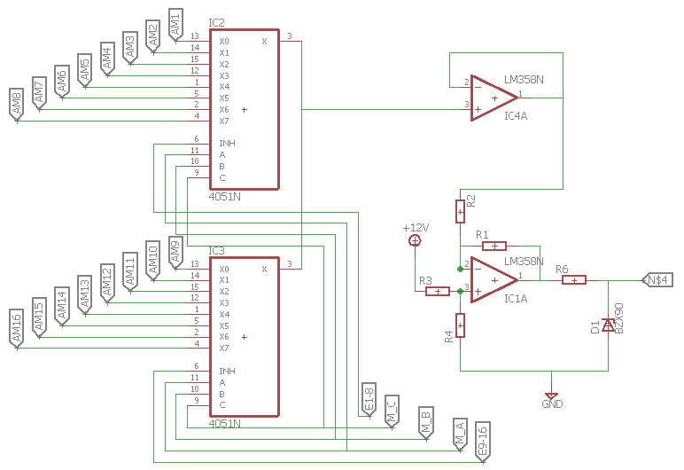
Design:
Analogue Shift Register Wiring

Slide 16
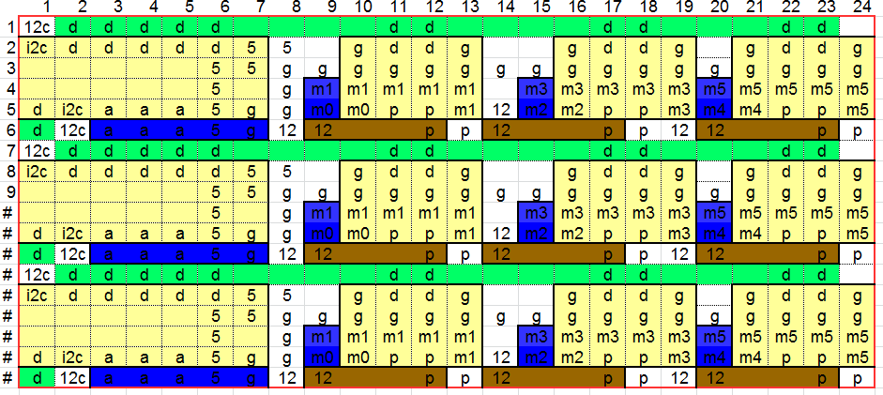
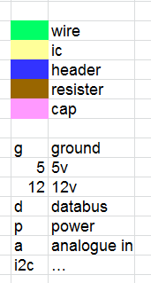
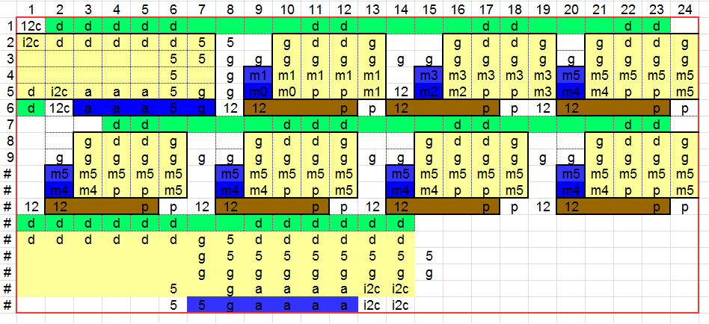
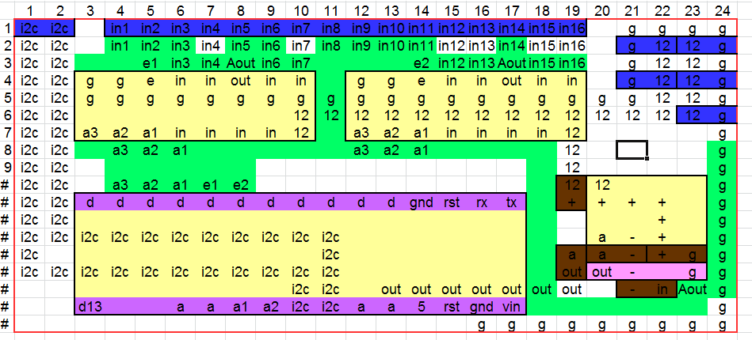
Design: Compressed Wiring diagram for Circuit Board
Proto-Matrix board templates, these act as wiring guides whilst manually soldering each of the 3 circuit boards.

Slide 17
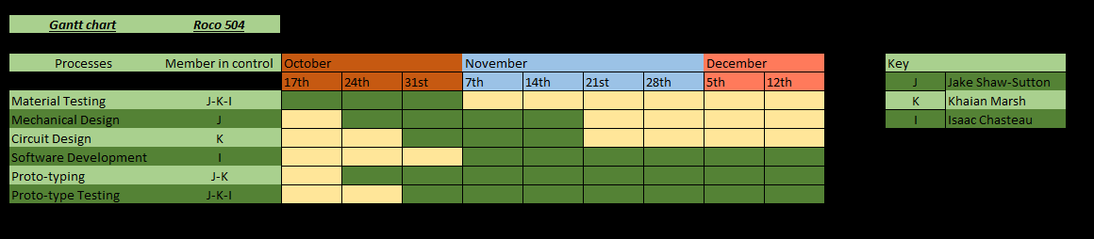
Future Plan:
Gantt Chart

